Slide 1


SIMATS ENGINEERING
SAVEETHA INSTITUTE OF MEDICAL AND TECHNICAL SCIENCES
Campus Resource Exchange Network(CREN): An Intelligent Academic Marketplace for Resource Sharing
CSA4305 – Internet Programming
Date :25/7/2026 Batch :09
Presented by:
Deepak V-192411021
Aaron Samuel S-192411022
Y. Abhay-192411219
Meghanadh A-192372281
Ebin Antony P-192373011
Guided by:
Dr. D. Sudhagar

Slide 2



ABSTRACT
A web-based platform exclusively for college students.
Enables buying, selling, borrowing, donating, and swapping academic resources.
Reduces educational expenses through resource sharing.
Ensures secure exchanges using QR-based verification.
Includes a trust and rating system to improve reliability.
Promotes sustainability by encouraging the reuse of resources.

Slide 3

OBJECTIVES
Students often have unused books, lab equipment, and project materials.
Many students purchase new resources despite unused items being available.
Existing platforms are not designed specifically for campus communities.
The proposed platform connects verified students within the same institution.
It provides a safe, organised, and user-friendly resource exchange system.
The platform supports sustainable and cost-effective academic practices.

Slide 4

PROBLEM STATEMENT
No dedicated platform for exchanging academic resources on campus.
Students rely on informal channels such as WhatsApp groups.
Lack of trust and verification during exchanges. High costs of textbooks and laboratory materials.
Unused academic resources often go to waste.
Difficulty in finding required resources quickly and securely.

Slide 5

OBJECTIVES
Develop a secure web platform for campus resource exchange.
Reduce students' academic expenses.
Promote the reuse and sharing of educational materials.
Verify users through institutional authentication.
Provide QR-based confirmation for secure transactions.
Build a trusted student community using ratings and reviews.

Slide 6

KEY FEATURES
Student Registration and Secure Login
Buy, Sell, Borrow, Donate, and Swap Resources
Smart Search and Category Filters
QR Code-Based Exchange Verification
Trust Score, Ratings, and Reviews
Admin Dashboard for Platform Management

Slide 7
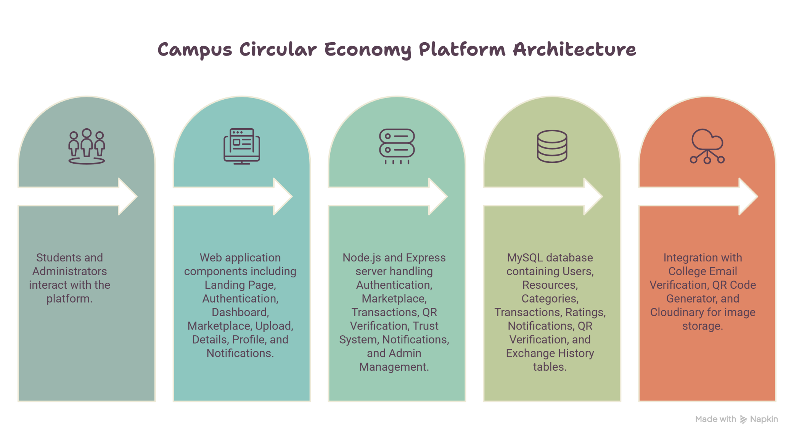
ARCHITECTURE DIAGRAM

Slide 8
MODULES
Module 1: User Authentication & Profile Management
Module 2: Resource Marketplace Management
Module 3: Exchange & Transaction Management
Module 4: QR Verification & Trust System
Module 5: Admin Dashboard & Analytics

Slide 9

EXPECTED OUTCOME
Easy access to affordable academic resources.
Reduced wastage through resource reuse.
Secure and transparent exchange process.
Improved collaboration among students.
Sustainable campus ecosystem with reduced educational costs.
Scalable platform that can be expanded to multiple colleges.

Slide 10
THANK YOU

